Slide 1
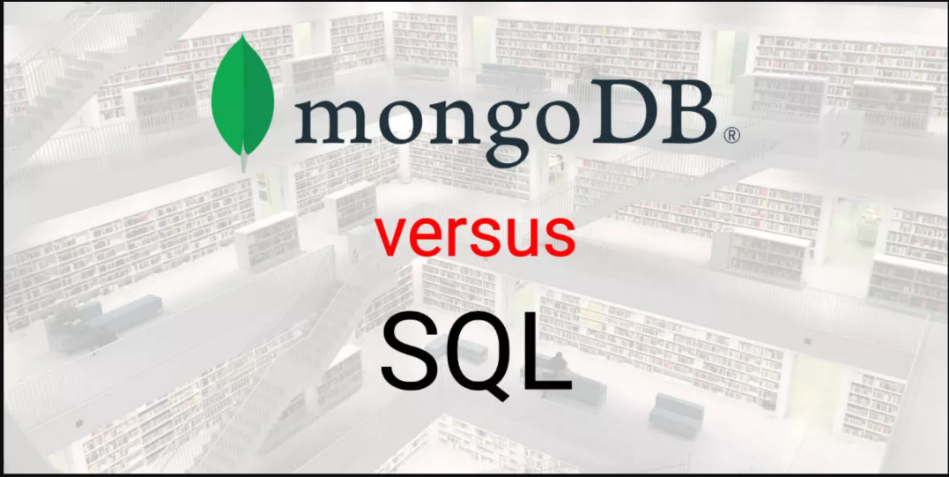
Introduction
The topic of this presentation is to compare NoSQL and SQL databases, with a specific focus on MongoDB and SQL.
NoSQL databases, such as MongoDB, are becoming increasingly popular for handling large amounts of unstructured and semi-structured data.
SQL databases, on the other hand, have been the traditional choice for structured data and are still widely used in enterprise environments.
This presentation will delve into the key differences and similarities between MongoDB and SQL, and explore when to use each type of database.

Slide 2

Defining MongoDB and its characteristics as a NoSQL database
MongoDB is a NoSQL database that uses a document-oriented data model. It stores data in a format similar to JSON, called BSON, which allows for flexibility and ease of use.
MongoDB uses a dynamic schema, meaning the structure of the data can change as needed, without the need to pre-define the fields or the structure of the data. This allows for easy adaptation to changing requirements and unstructured data.
MongoDB offers horizontal scaling, which allows for easy addition of more hardware resources to handle increased load. This makes MongoDB well suited for handling large amounts of data or traffic.
Other key features of MongoDB include high performance and availability, rich query language, and built-in support for data aggregation.

Slide 3

Definig SQL and it’s caracteristics as a relddational database
SQL (Structured Query Language) is a relational database management system (RDBMS) that uses a structured data model and a fixed schema. This means that the structure of the data and the fields must be defined in advance, and any change to the schema requires modification to the database.
SQL databases typically use vertical scaling, which means adding more resources to a single server to handle increased load. This can include adding more memory, CPU, or storage.
SQL is designed to handle structured data and it provides powerful tools to query and manipulate the data. SQL provides a declarative query language that allows the user to describe the desired result, and the database system figures out how to efficiently execute the query
SQL databases are widely used in enterprise environments, and they provide a lot of features that help to maintain data integrity, security, and scalability.

Slide 4
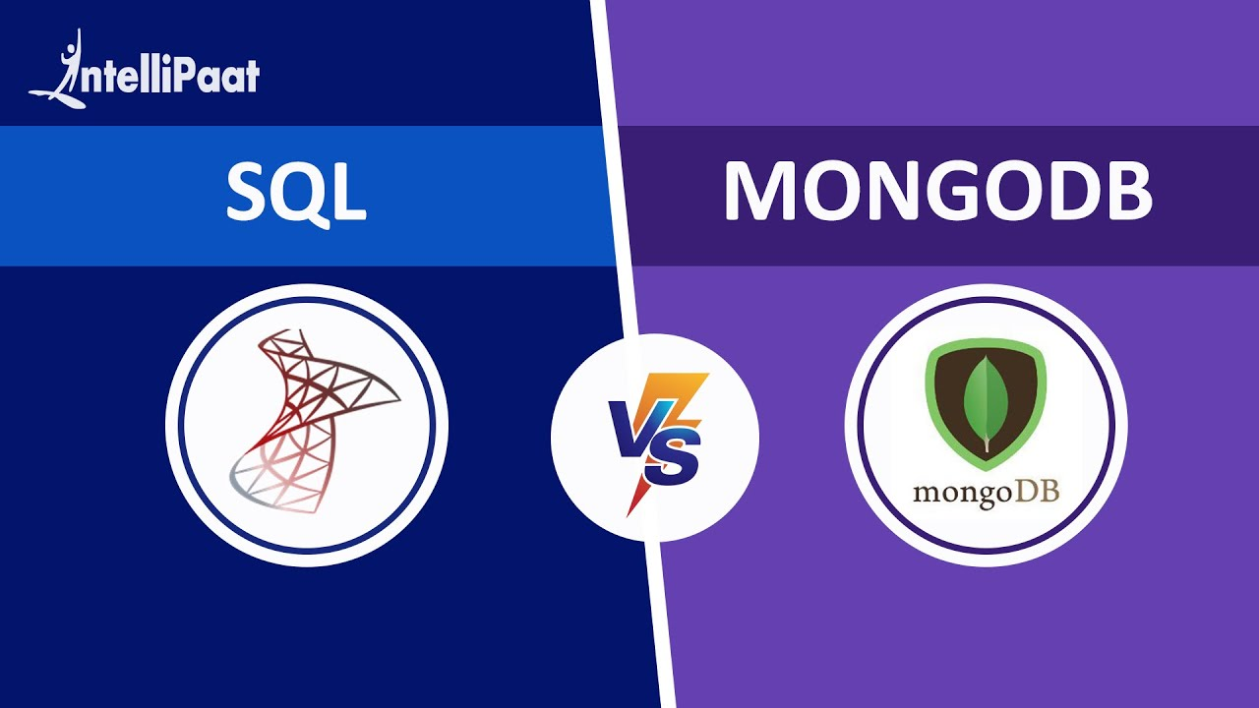
Comparing and contrast MongoDB and SQL in terms of data model, schema, scalability, and query language
MongoDB and SQL have different data models, MongoDB is document-oriented and it stores data in a format similar to JSON, while SQL is relational and stores data in tables with defined fields and relationships.
MongoDB uses a dynamic schema, allowing for easy adaptation to changing requirements and unstructured data, while SQL uses a fixed schema, requiring predefined fields and structure.
MongoDB offers horizontal scaling for easy addition of more hardware resources, while SQL uses vertical scaling by adding more resources to a single server.
MongoDB has a rich query language that allows for easy manipulation of unstructured data, while SQL has a powerful declarative query language that allows for precise querying of structured data.
The trade-offs between using MongoDB and SQL include flexibility vs structure, ease of scaling vs control, and performance in handling unstructured data vs structured data. It's important to choose the right database based on the specific use case and requirements.

Slide 5
Conclusion
In summary, MongoDB is a NoSQL database that uses a document-oriented data model, dynamic schema, and horizontal scaling. SQL is a relational database that uses a structured data model, fixed schema, and vertical scaling.
MongoDB is well suited for handling large amounts of unstructured and semi-structured data, while SQL is better suited for structured data and more complex queries.
MongoDB offers more flexibility and ease of scaling, while SQL offers more control and data integrity.
Based on specific use cases, it is recommended to use MongoDB for applications that require high performance and scalability, such as big data and real-time analytics, and use SQL for applications that require data integrity and complex queries, such as enterprise resource planning and customer relationship management.

